Slide 1

Exploring and Addressing Security Threats in Wireless and Mobile Networks Proposal Thesis by Tian Xie Nov. 2020 Michigan State University
Notes:
Hello everyone, today I’ll give a lecture about my comprehensive exam thesis exploring and addressing security vulnerabilities in mobile networks.
Exploring and Addressing Security Vulnerabilities in Wireless and Mobile Networks
with an emphasis on cellular networks and Wi-Fi networks

Slide 2
Guidance Committee
Prof. Guan-Hua Tu (advisor)
Prof. Li Xiao
Prof. Mi Zhang
Prof. Zhichao Cao
Thank you for serving on my committee!
Notes:
First of all, I would really appreciate professors for serving on my committee! Thank you very much!

Slide 3
Research Focus
My research focus is to explore and address design defects, operational slips, and implementation issues that cause negative impacts on mobile and wireless networks, with an emphasis on cellular networks and Wi-Fi networks.
In cellular networks, I mainly targeted the security of two essential services: (1) voice and (2) data services.
Voice services: Wi-Fi calling (TMC’20, CNS’18 Best paper award, Google Security Reward), VoLTE security (MobiCom’20)
Data services: IoT data service charging security (TMC’20)
In Wi-Fi networks, I collaborated with lab members to secure Wi-Fi-connected IoT devices.
Securing IoT devices via Commodity Router (MobiSys’20)
Exploring the insecurity of Home Voice Assistants (CNS’18)
Notes:
However, any design defects, operational slips, implementation issues can lead to serious negative impacts on the cellular network.
(click) My security research focuses on two key services, mobile data service and the voice service. Nowadays, more and more people contact friends via apps. Thus, my research does not include the text services.
(click) For data services, some state-of-the-art papers published in CCS have carefully studied the data service on the smartphone. Different from them, my security research targets on the data service specific for the IoT device. Due to the design of IoT, the data service on IoT is different from the data service on the non-IoT device.
(click) For voice service, the academia has studied some common voice technologies including CS Fallback and VoLTE. My research target focuses on another new released technology VoWiFi. To the best of our knowledge, our VoWiFi work was the first work to study VoWiFi and won a Google Security Award.
Voice based (IMS server) (VoWiFi can be extended to 4G/5G)
Data based
Text based. Little people are using it.

Slide 4
Publications
Cellular network security
Voice services
Tian Xie, Guan-Hua Tu, Bangjie Yin, Chi-Yu Li, Chunyi Peng, Mi Zhang, Hui Liu, Xiaoming Liu,The Untold Secrets of WiFi-Calling Services: Vulnerabilities, Attacks, and Countermeasures,, IEEE Transactions on Mobile Computing (TMC) 2020.
Yu-Han Lu, Chi-Yu Li, Yao-Yu Li, Sandy Hsin-Yu Hsiao, Tian Xie, Guan-Hua Tu, Wei-Xun Chen , Ghost Calls from Operational 4G Call Systems: IMS Vulnerability, Call DoS Attack, and Countermeasure, ACM MobiCom’20
Tian Xie, Guan-Hua Tu, Chi-Yu Li, Chunyi Peng, Jiawei Li, and Mi Zhang,The Dark Side of Operational Wi-Fi Calling Services,, IEEE IEEE Communications and Network Security (CNS)’18 (Best Paper Award, Google Security Reward)
Tian Xie, Chi-Yu Li, Guan-Hua Tu and Jiliang Tang, How Voice Service Threatens Cellular-connected IoT Devices in the Operational 4G LTE Networks, IEEE ICC’18
Data services
Tian Xie, Guan-Hua Tu, Chi-Yu Li, Chunyi Peng, How Can IoT Services Pose New Security Threats In Operational Cellular Networks?, IEEE Transactions on Mobile Computing (TMC) 2020.
WiFi network security
IoT services
Xinyu Lei, Guan-Hua Tu, Chi-Yu Li, Tian Xie, Mi Zhang, SecWIR: Securing Smart Home IoT Communications via Wi-Fi Routers with Embedded Intelligence, ACM MobiSys’20
Xinyu Lei, Guan-Hua Tu, Alex Liu, Chi-Yu Li, and Tian Xie, The Insecurity of Home Digital Voice Assistants - Vulnerabilities, Attacks and Countermeasures, IEEE Communications and Network Security (CNS)’18
Internet security
User account registration services
Tian Xie, Sihan Wang, Guan-Hua Tu, Chi-Yu Li, Xinyu Lei, Exploring the Insecurity of Google Account Registration Protocol via Model Checking, IEEE Symposium Series on Computational Intelligence (SSCI)’19
Notes:
However, any design defects, operational slips, implementation issues can lead to serious negative impacts on the cellular network.
(click) My security research focuses on two key services, mobile data service and the voice service. Nowadays, more and more people contact friends via apps. Thus, my research does not include the text services.
(click) For data services, some state-of-the-art papers published in CCS have carefully studied the data service on the smartphone. Different from them, my security research targets on the data service specific for the IoT device. Due to the design of IoT, the data service on IoT is different from the data service on the non-IoT device.
(click) For voice service, the academia has studied some common voice technologies including CS Fallback and VoLTE. My research target focuses on another new released technology VoWiFi. To the best of our knowledge, our VoWiFi work was the first work to study VoWiFi and won a Google Security Award.
Voice based (IMS server) (VoWiFi can be extended to 4G/5G)
Data based
Text based. Little people are using it.

Slide 5
Publications Will be Presented Today
Cellular network security
Voice services
Tian Xie, Guan-Hua Tu, Bangjie Yin, Chi-Yu Li, Chunyi Peng, Mi Zhang, Hui Liu, Xiaoming Liu,The Untold Secrets of WiFi-Calling Services: Vulnerabilities, Attacks, and Countermeasures,, IEEE Transactions on Mobile Computing (TMC) 2020.
Yu-Han Lu, Chi-Yu Li, Yao-Yu Li, Sandy Hsin-Yu Hsiao, Tian Xie, Guan-Hua Tu, Wei-Xun Chen , Ghost Calls from Operational 4G Call Systems: IMS Vulnerability, Call DoS Attack, and Countermeasure, ACM MobiCom’20
Tian Xie, Guan-Hua Tu, Chi-Yu Li, Chunyi Peng, Jiawei Li, and Mi Zhang,The Dark Side of Operational Wi-Fi Calling Services,, IEEE IEEE Communications and Network Security (CNS)’18 (Best Paper Award, Google Security Reward)
Tian Xie, Chi-Yu Li, Guan-Hua Tu and Jiliang Tang, How Voice Service Threatens Cellular-connected IoT Devices in the Operational 4G LTE Networks, IEEE ICC’18
Data services
Tian Xie, Guan-Hua Tu, Chi-Yu Li, Chunyi Peng, How Can IoT Services Pose New Security Threats In Operational Cellular Networks?, IEEE Transactions on Mobile Computing (TMC) 2020.
WiFi network security
IoT services
Xinyu Lei, Guan-Hua Tu, Chi-Yu Li, Tian Xie, Mi Zhang, SecWIR: Securing Smart Home IoT Communications via Wi-Fi Routers with Embedded Intelligence, ACM MobiSys’20
Xinyu Lei, Guan-Hua Tu, Alex Liu, Chi-Yu Li, and Tian Xie, The Insecurity of Home Digital Voice Assistants - Vulnerabilities, Attacks and Countermeasures, IEEE Communications and Network Security (CNS)’18
Internet security
User account registration services
Tian Xie, Sihan Wang, Guan-Hua Tu, Chi-Yu Li, Xinyu Lei, Exploring the Insecurity of Google Account Registration Protocol via Model Checking, IEEE Symposium Series on Computational Intelligence (SSCI)’19
Notes:
However, any design defects, operational slips, implementation issues can lead to serious negative impacts on the cellular network.
(click) My security research focuses on two key services, mobile data service and the voice service. Nowadays, more and more people contact friends via apps. Thus, my research does not include the text services.
(click) For data services, some state-of-the-art papers published in CCS have carefully studied the data service on the smartphone. Different from them, my security research targets on the data service specific for the IoT device. Due to the design of IoT, the data service on IoT is different from the data service on the non-IoT device.
(click) For voice service, the academia has studied some common voice technologies including CS Fallback and VoLTE. My research target focuses on another new released technology VoWiFi. To the best of our knowledge, our VoWiFi work was the first work to study VoWiFi and won a Google Security Award.
Voice based (IMS server) (VoWiFi can be extended to 4G/5G)
Data based
Text based. Little people are using it.

Slide 6



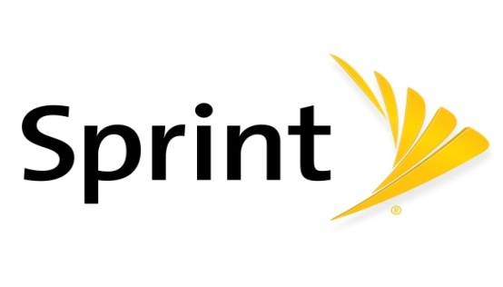




Cellular Networks
Using the cellular networks for ubiquitous data, voice, and text services.
Voice and text communication
Chatting with others on Apps
Browsing the websites
Conducting monetary transactions
Accessing smart devices
More new features/functions are added…
Notes:
Then, let’s take a look at the cellular mobile network.
People can the cellular network for ubiquitous mobile data, voice, and text services, including the voice and text communication, chatting on Apps, browsing the websites, conducting monetary transactions. More and more features are added and provided by the mobile network.

Slide 7
Part I: Data Service
Notes:
So, let’s start the first part, data service.

Slide 8
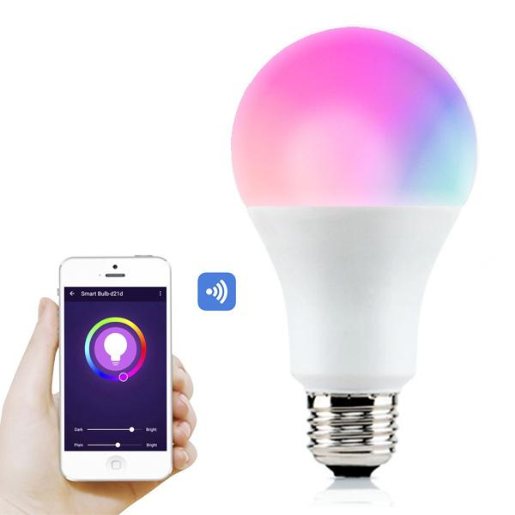
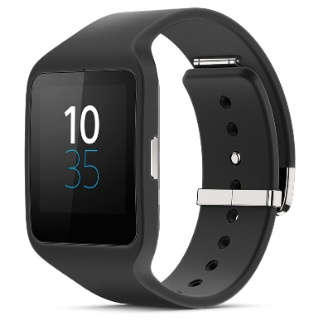
Internet-of-Things (IoT) Era
‘Things’ include a wide variety of devices
House appliances
Hotspot on vehicles
Wearable devices
Heart monitoring implants
Cameras streaming live feed of wild animals
Biochip transponders on farm animals
Etc.
Notes:
Nowadays, we are in the Internet of things era. Things cover a lot of devices. (Click) such as house appliances, hotspot on vehicles, wearable devices, heart monitoring, cameras, biochip transponders, and so on.

Slide 9
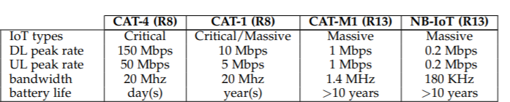
Cellular IoT
Rel-8/ Cat. 4, Rel-8/Cat. 1, etc.
Providing wide range data rates (0.2 Mbps to 150 Mbps) with low-power consumption for IoT devices.
Already being proposed in 4G LTE networks and can be merged with existing networks
Notes:
Cellular network has the specific standards to support cellular IoT, such as Cat.4, Cat1, Cat-M1 and NB-IoT. They provide wide range data rates from .2 to 150 Mbps with low-power consumption for IoT devices. Those specifics have been proposed and merged to the existing networks.
In this work, we focus on the cellular IoT. It is not only that cellular IoT devices will reach 1.5 billion in 2021 with an annual growth rate of 24.6%, but also Major U.S. cellular network operators including Verizon, ATT, and T-Mobile have launched cellular IoT services based on Rel-8/ Cat. 4, one of the most popular ones for wearable devices, car-connected hotspots, etc.

Slide 10
Key Problem for Cellular IoT Services
The charging plan for cellular IoT is different from non-IoT devices.
E.g., $40 for a smartphone, whereas $10 for smartwatch or other connected devices
Does the existing network infrastructure serving conventional non-IoT devices be able to well support those low-profile IoT devices?
No!
Notes:
Although the cellular IoT service is merged on the existing 4G LTE network, the charging plan for cellular IoT is different from non-IoT devices due to its limited use scenarios. For instance, we usually need to pay 40 dollars per month for a smartphone, whereas IoT devices such as smartwatch only cost 10 dollars.
we thus naturally has a critical question. (click) Does the existing network infrastructure serving conventional non-IoT devices be able to well support those low-profile IoT devices?
(click) Unfortunately, the answer is No.

Slide 11
Key Problem for Cellular IoT Services
We have two works to study this key problem:
How Can IoT Services Pose New Security Threats In Operational Cellular Networks? (Operators are victims.)
How Voice Service Threatens Cellular-Connected IoT Devices in the Operational 4G LTE Networks (Users are victims)
We discovered the charging-related security vulnerabilities and analyzed the root causes in cellular IoT services.
We proposed the proof-of-concept attacks and accessed their real-world impact.
We developed the standard-compliant solutions to mitigate attack incentives practically.
Notes:
We have two works to study this key problem.
In the first work, How Can IoT Services Pose New Security Threats In Operational Cellular Networks? Operators are the victims. In the second work, How Voice Service Threatens Cellular-Connected IoT Devices in the Operational 4G LTE Networks , users are the victims.
(Click) In our work, we discovered the charging-related security vulnerabilities and analyzed the root causes in cellular IoT services.
(Click) we proposed the proof-of-concept attacks and accessed their real-world impact.
(Click) we developed the standard-compliant solutions to attack incentives practically.

Slide 12
Part I
Background
Vulnerabilities
Proof-of-concept Attacks
Solution

Slide 13
Cellular IoT Primer
Cellular IoT Architecture
Core Network
Management
Control
Data
Radio Access Network
Notes:
First, let’s take look at the cellular iot architecture.
4G LTE consists two major components: RAN and CN.
(click) RAN offers various radio specifications to the diversified IoT devices (car connected devices, smart meters, etc.)
(click) Core Network has three planes, which are Management plane, Control plane, and Data plane.

Slide 14
Cellular IoT Primer
Cellular IoT Architecture
Management Plane
Charging Gateway Function (CGF)
Billing System
Notes:
Charging Gateway Function and Billing System are used to account for the service amounts consumed by mobile devices and generate their bills. Here the user traffic is reported by 4g gateways

Slide 15
Cellular IoT Primer
Cellular IoT Architecture
Control plane
Home Subscriber Server (HSS)
Mobility Management Entity (MME) (Power Saving)
Notes:
There are two main functions in Control plane.
HSS records the IoT devices’ services.
MME administrates mobility, authentication, and resource reservation, including the IoT power saving mode.

Slide 16
Cellular IoT Primer
Cellular IoT Architecture
Data plane
CN connects RAN, IMS, and Internet
Supporting data and voice/text over IMS
Notes:
In data plane, Core Network connects RAN, IMS, and Internet via the gateways that forward packets between them.
As a result, we can see that the 4G LTE Network architecture for cellular iot is similar to the network architecture for non-iot.

Slide 17
Part I
Background
Vulnerabilities
Proof-of-concept Attacks
Solution
Notes:
Next, I will introduce the discovered vulnerabilities.

Slide 18
Finding 1: Non-IoT devices can masquerade as IoT ones.
Notes:
Our first finding is that Non-IoT devices can masquerade as IoT ones . We discovered two vulnerabilities caused by the design issues. They show that current security mechanisms for cellular IoT support in the 3GPP standards are not sufficient to secure carriers due to the lack of authentication between UE and carrier.
Each of vulnerabilities corresponds to a lack of mutual authentication between two parties.

Slide 19
Vulnerability 1
V1: An IoT SIM card can be used for a non-IoT device. (Design Defect of Device)
Validation:
We use the SIMs for CAT-4, CAT-1, and CAT-M1 IoT devices from two operators on the smartphones (non-IoT).
All smartphones successfully obtain IP addresses from the cellular networks and access the Internet without any issues.
Notes:
The first vulnerability is that An IoT SIM card can be used for a non-IoT device. It is the design defect of device.
(click)
We validate this vulnerability by purchase IoT SIM cards used for CAT-4, CAT-1, and CAT-M1 IoT devices. We insert each of them into our test smartphones, properly configure their networking settings, and then restart the phones. Our experimental results on two US operators show that all the smartphones successfully obtain IP addresses from the cellular networks and access the Internet without any issues.

Slide 20
Vulnerability 2
V2: The infrastructure is unable to correctly identify IoT and non-IoT devices. (Design Defect of Infrastructure)
Existing identification method :
Initially, both operators can correctly identify connected non-IoT or IoT devices, and show the device information on their web pages.
How operators identify the connected devices?
By analyzing the control plane protocol traces, we found that the infrastructure identifies a connected device based on the IMEI carried in its IDENTITY RESPONSE message sending by the device when connecting to the network.
Notes:
The second vulnerability is that the infrastructure is unable to correctly identify IoT and non-IoT devices, which is Design Defect of Infrastructure.
We examine that whether the infrastructure can be fooled into thinking that a smartphone is an IoT device.
(click)
First, we study the existing identification method. both operators can correctly identify connected non-IoT or IoT devices and show the device information on their web pages. How operators identify the connected devices?
(click)
By analyzing the control plane trace, we found that the infrastructure identifies a connected device by the IMEI carried in the identity response message sending from the device.

Slide 21
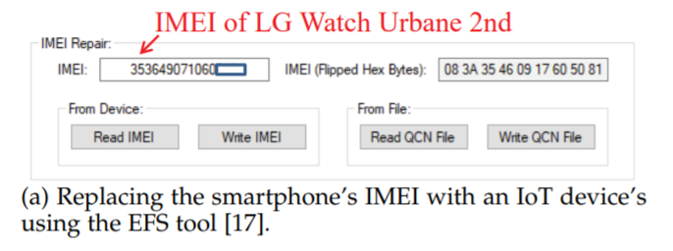
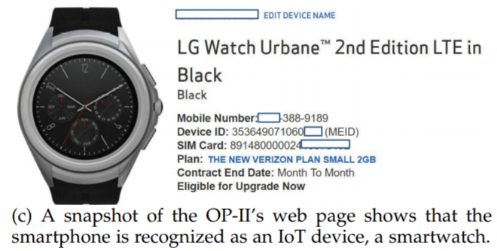
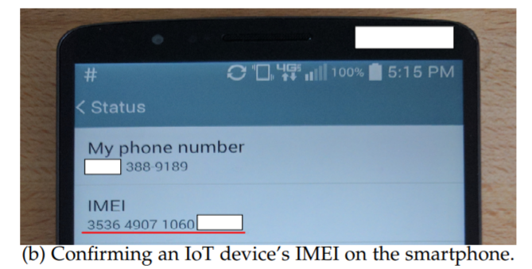
V2 Validation
Validation:
Making IMEI spoofing on a smartphone (LG G3) to masquerade as an IoT device (LG Watch Urbane 2nd).
Notes:
We next make a IMEI spoofing on a smartphone. We replace the smartphone’s IMEI with a IoT device’s IMEI via the EFS tool. Then, we can see that the operator shows the smartphone is recognized as an IoT device.

Slide 22
Finding 2: There Is No Limitation Imposed on IoT Data Service.
Notes:
The second finding is that there is no limitation imposed on IoT data service.
The answer is expected to be yes when the infrastructure offers differential data services to IoT and non-IoT devices. However, this is not the case for the tested carriers. We thus find vulnerability 3.

Slide 23
Vulnerability 3
V3: The infrastructure does not impose any restrictions on IoT data services. (Operational Slip of Infrastructure)
Validation:
Using iPerf to examine TCP throughput performance on three devices and two operators:
(1) an IoT device (i.e., LG Watch Urbane 2nd) equipped with an IoT SIM card
(2) a smartphone (i.e., Samsung S5) with a non-IoT SIM card
(3) the smartphone spoofing the IoT device’s IMEI with an IoT SIM card.
Notes:
Thus, the third vulnerability is that the The infrastructure does not impose any restrictions on IoT data services, which is the operational slip of infrastructure.
(click)
We validate this vulnerability by Using iPerf to examine TCP throughput performance on three devices, an IoT device with a IoT sim, a smartphone with a non-IoT sim, and a smartphone spoofing the IoT device’s IMEI with an IoT SIM card.

Slide 24
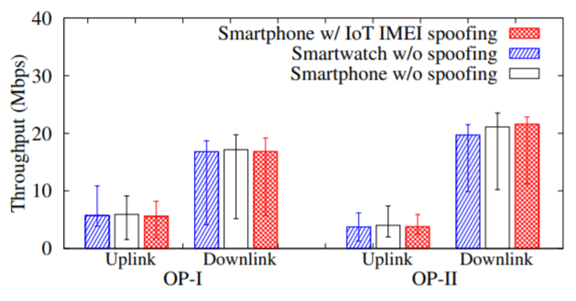
V3 Validation
Validation observation:
We observe that all the three devices have comparable performance on the uplink and downlink throughput in each operator’s network.
Networks do not enforce any noticeable restrictions on IoT devices in terms of data transmission rates!
Notes:
As shown in the figure, three devices have comparable performance on the uplink and downlink rate on both carriers.
(click)
So, networks do not enforce any noticeable restrictions on IoT devices in terms of data transmission rates.

Slide 25
Finding 3: There Is No Limitation on Cellular IoT Use Scenarios.
Notes:
Current carriers offer cheaper device access fees to some IoT devices due to their limited use scenarios. However, this is not the case for the tested carriers. Finding 3 is that There Is No Limitation on Cellular IoT Use Scenarios.
We thus find vulnerability 4.

Slide 26
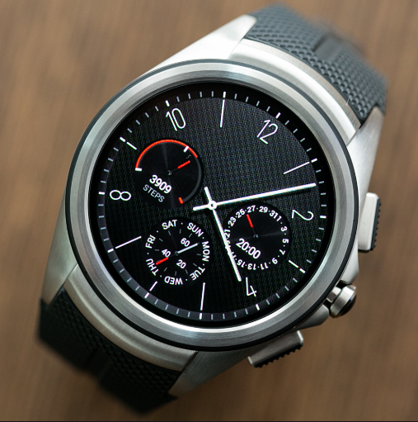
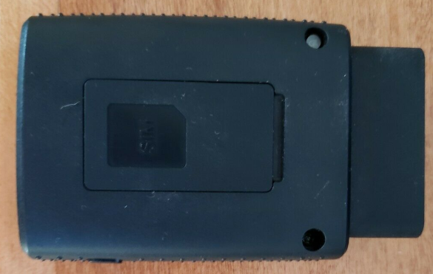
Vulnerability 4
V4: The infrastructure is unable to confine IoT devices to their pre-defined use scenarios. (Operational Slip/Implementation of Infrastructure)
Validation:
We validate this vulnerability on two types of popular IoT devices: car-connected mobile hotspots and smartwatches.
Notes:
It is the fourth vulnerability. The infrastructure is unable to confine IoT devices to their pre-defined use scenarios. It is Operational Slip/Implementation of Infrastructure.
(click)
We validate this vulnerability on two types of popular IoT devices: car-connected mobile hotspots and smartwatches.

Slide 27
Vulnerability 4 Validation
Car-connected Hotspots:
Not Limited to only Vehicles:
A car-connected hotspot can continue to be used outside vehicles.
We build such a power supply that can generate a 12V DC current with a power bank and a voltage regulator that can successfully power the car-connected hotspot.
We connect a Wi-Fi client to the hotspot and use the client to keep generating traffic to/from the Internet.
The traffic is not interrupted for a whole day!
Notes:
For car-connected hotspot
(click)
It is not limited to only vehicles.
(click)
A car-connected hotspot can continue to be used outside vehicles.
(click)
We build such a power supply that can generate a 12V DC current with a power bank and a voltage regulator that can successfully power the car-connected hotspot.
(click)
We connect a Wi-Fi client to the hotspot and use the client to keep generating traffic to/from the Internet
(click)
Our experiment result shows that the traffic is not interrupted for a whole day!

Slide 28
Vulnerability 4 Validation
Smartwatches
Not Constrained by Hardware or Software:
For smartwatches, we examine whether the network forbids a smartphone’s data packets which are forwarded by the smartwatch.
We develop a data forwarding application on the smartwatch.
All the transmitted packets are received by our Internet server. No restrictions from two examinate carrier networks are observed for this usage.
Notes:
For smartwatch.
(click)
It is Not Constrained by Hardware or Software. Network is not able to forbid smartphone’s packets forwarded by the smartwatch.
A data forwarding application on the smartwatch is developed. It first receives the smartphone’s data packets from the Wi-Fi interface and sends them to our external UDP server on the Internet through the cellular network interface.
(Click)
When we run the data forwarding application on the smartwatch, All the transmitted packets are received by our Internet server. No restrictions from two examinate carrier networks are observed for this usage.

Slide 29
Finding 4: IoT Service has improper charging function on IoT devices.
Notes:
Finding 4 is that IoT Service has improper charging function on IoT devices.

Slide 30
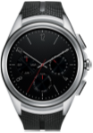
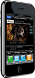
Bearers used in Cellular Network
Conventional charging function operates on a per-bearer basis; however, some IoT devices cannot support that.
Time-based charging
VoLTE voice
4G Gateway
4G Gateway
VoLTE voice & mobile data services
Mobile data services
Smartphone
Smartwatch
Volume-based charging
Notes:
Conventional charging function operates on a per-bearer basis; however, some IoT devices cannot support that.
For the smartphone on 4g lte network, it can have multiple bearers for different purposes. For example, (click) there is one bearer for VoLTE voice service. (click) there is also a bearer for the data service. (click) Different services have different charging mechanisms: time-based charging, (click) volume-based charging
However, IoT devices may have hardware limitation that only one bearer can be supported or IoT devices are unable to always keep multiple bearers. (click) (click) Normally, a single bearer of IoT device may server both VoLTE service and mobile data services. Without carefully examining the charging functions for IoT devices, this vulnerability may cause the monetary loss.

Slide 31
Bearers on Phones (left) and Smartwatch (right)
Two network interfaces
Same experiment location
Notes:
Next, we show the bearers on the smartphone and the smartwatch.
The figure shows two screen captures of the network interface of our test smartphone and smartwatch in the same location.
(click)
As introduced before, a VoLTE-enabled smartphone usually maintains two bearers: one for mobile data service, another for VoLTE signaling messages.
In our test smartphones, two network interfaces are created for data and VoLTE bearers.
(click)
For test smartwatches, Only one interface is observed on the smartwatch, when the watch enable VoLTE and mobile data.
they can’t always keep multiple network interfaces on.

Slide 32
Vulnerability 5
V5: IoT service has the mismatched charging. (Design Defect of Infrastructure)
Currently, the service plan for IoT devices provided by operators is volume-based charging.
This bearer’s charging method is volume-based. Thus, the VoLTE service will be charged too. (VoLTE signaling is not free!)
Notes:
So the vulnerability 5 is that IoT service has the mismatched charging, which is Design Defect of Infrastructure.
Two different services should have two different bearers with two charging method, volume based for data service and time based for voice service.
(click)
Currently, the service plan for IoT devices provided by operators is volume-based charging.
(click)
Thus, the VoLTE service will be charged too. Even worse, the VoLTE signaling will be charged as well.
So, it should be a question, which charging function is used on the smartwatch when the smartwatch relies on a single bearer to serve both the data and VoLTE service, the services will be assigned one charging method, either volume-based or the time-based scheme. (click, click)
When VoLTE signaling is not free in terms of traffic volume, signaling spams can cause mobile users to be overcharged.

Slide 33
Vulnerability 5
Validation:
We make VoLTE calls to the smartwatch and then check its data usage volume.
We record the data usage volume on the smartphone by developed a smartwatch application using the classTrafficStats.
50 VoLTE calls are made.
It is observed that the average data volumes of the VoLTE signaling and VoLTE voice traffic are around 13 KB per call.
We confirm the data usage of the smartwatch on the operator side.
Notes:
To validate this vulnerability, (click) we make VoLTE calls to the smartwatch and check its data usage volume. We developed a app using the class trafficstats to record the data usage on the smartwatch.
(click)
50 VolTE calls are made. It is observed that the average data volumes of the VoLTE signaling and VoLTE voice traffic are around 13 KB per call. We confirm the data usage of the smartwatch on the operator side.

Slide 34
Part I
Background
Vulnerabilities
Proof-of-concept Attacks
Solution
Notes:
Next, I’ll introduce the proof-of-concept attacks using our discovered vulnerabilities.

Slide 35
Attack 1: IoT Masquerading
IoT masquerading attack is launched based on the vulnerabilities V1, V2, and V3. (Operators are the victims.)
An adversary can add a smartwatch to the account and obtain a IoT SIM card from the carrier. Then, a smartphone can masquerade as the smartwatch using the IMEI spoofing.
Notes:
The first attack is IoT masquerading attack launched based on vulnerability 1, 2, and 3. In this attack, operators are the victims.
(click)
An adversary can add a smartwatch to the account and obtain a IoT SIM card from the carrier. Then, a smartphone can masquerade as the smartwatch using the IMEI spoofing.

Slide 36
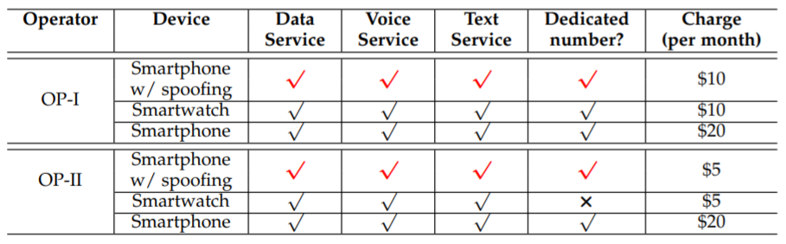
Attack 1: IoT Masquerading
According to the experimental result, it is observed that this attack can successfully be launched on both two U.S. top operators.
Notes:
We observed that this attack can successfully be launched on both two U.S. top operators.
(click)
With the attack smartphone, the adversary can make voice calls, send/receive short messages and access the Internet, but only pay the IoT device access fee. The adversary can save 50% and 75% of the smartphone device access charges, respectively

Slide 37
Attack 2: Car-connected IoT Abuse
A proof-of-concept attack to access the real-world damages of V4. (Operators are the victims)
We first turn a car-connected IoT hotspot into a mobile hotspot.
We evaluate the performance of the car-connected IoT hotspot (Mobley) and an ordinary mobile hotspot (Velocity).
Notes:
In the second attack, we use a proof-of-concept attack to access the real-world damages of vulnerability 4. In this attack, operators are the victims.
(click)
We first turn a car-connected IoT hotspot into a mobile hotspot and then evaluate the performance of the car-connect IoT hotspot and an ordinary mobile hotspot.

Slide 38
Attack 2: Car-connected IoT Abuse
We connect a laptop to each of those two hotspots and gauge its uplink/downlink performance.
In the test, the position of hotspots are fixed and put together.
The laptop is placed at six different locations, which are spaced at 2-meter intervals.
Six locations are labeled as S1 (closest), S2, S3, S4, S5, S6 (farthest).
Test the throughput for 10 runs in each case.
Notes:
Specifically, We connect a laptop to each of those two hotspots and gauge its uplink/downlink performance.
In the test, the position of hotspots are fixed. The laptop is placed at 6 different locations, labeled as S1 to S6. We test the throughput for 10 runs in each case.

Slide 39
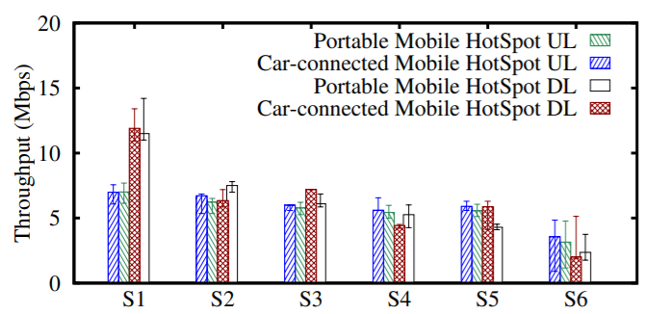
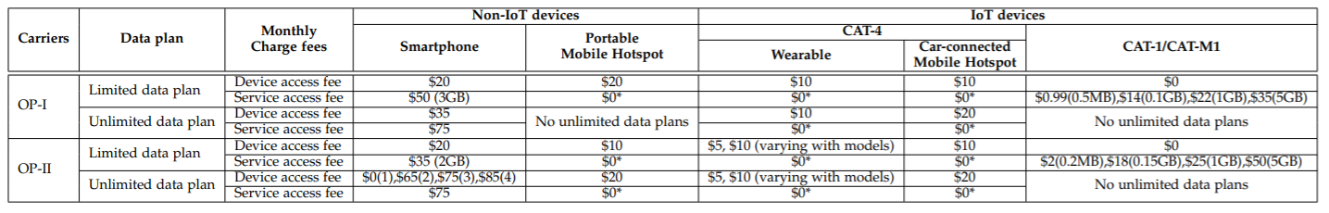
Attack 2: Car-connected IoT Abuse
The two hotspots have the comparable performance for both uplink and downlink!
50% cheaper hotspot fee!
Notes:
(click) This figure shows the throughput performance of two hotspot. Clearly, both hotspots have the comparable performance for both uplink and downlink.
Neither of the hotpots outperforms the other.
(click) However, compared to the ordinary hotspot, using the car-connected hotspot, the adversary only needs to pay half hotspot fee as shown in the following table. See, car-connected hotspot fee is 10 dollars where the portable mobile hotspot is 20 dollars per month.
Specifically, the differences between their median throughput results are
within only 5.62% and 2.03% for all the cases in the OP-I and
OP-II networks respectively. Neither of the hotspots always
outperforms the other.

Slide 40
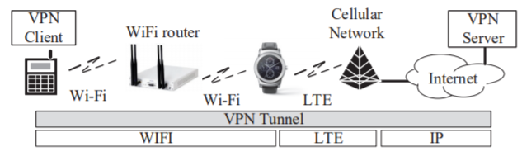
Attack 3: Wearable IoT abuse
A proof-of-concept attack to access the real-world damages of V4. (Operators are the victims.)
Attack 3:
We devise an attack that abuses a wearable IoT, smartwatch, to be a mobile data gateway to provide the Internet access through the mobile data service.
Notes:
Attack 3 is a proof-of-concept attack to access the real-world damages of vulnerability 4 as well. In this attack, operators are the victim.
(click)
In this attack, we devise an attack that abuses a smartwatch to be a mobile data gateway to provide the Internet access through the mobile data service.
The bottom figure shows the network architecture that turns a smartwatch to a mobile data gateway. It consists of four components: (1) a VPN server deployed on the Internet, (2) an IoT device supporting both Wi-Fi and cellular networks (e.g., LG Watch Urbane and Samsung Gear S3), (3) a Wi-Fi AP, and (4) a VPN client installed on a smartphone. Both the smartphone and the smartwatch connect to the AP. The VPN client on the smartphone establishes a VPN tunnel with the VPN server, and the smartwatch forwards data between the VPN client and the VPN server through its Wi-Fi and LTE interfaces.

Slide 41
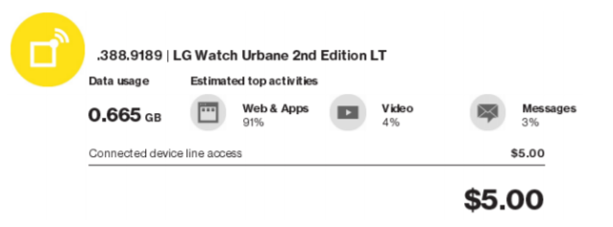
Attack 3: Wearable IoT abuse
The 91% traffic volume consumed by the web and applications is mostly used by the application that forwards data between the Wi-Fi and LTE networks.
It allows the adversary to pay 50% and 75% less in this two U.S. networks, respectively.
Notes:
This figure shows the traffic used by the watch.
(click)
91% traffic volume consumed by the web and applications is mostly used by the application that forwards data between the Wi-Fi and LTE networks.
(click)
Thus, this attack allows the adversary to pay 50% and 75% less in the two U.S. networks, respectively.

Slide 42
Attack 4: IoT Overcharging
An attack that empowers the adversary to remotely cause a mobile victim to be overcharged using V5. (Users are the victims)
In this attack, the adversary sends a large number of VoLTE call signaling spams to the victim’s smartwatch.
The victim is unaware of the attack since the adversary never causes the victim’s smartwatch to ring.
Notes:
The last proof-of-concept attack 4, IoT overcharging attack can empower the adversary to remotely cause a mobile victim to be overcharged using V5.
(click)
In this attack, the adversary sends a large number of VoLTE call signaling spams to the victim’s smartwatch.
The victim is unaware of the attack since the adversary never causes the victim’s smartwatch to ring.

Slide 43
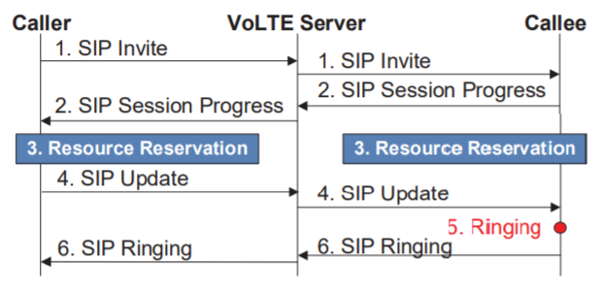
Attack 4: IoT Overcharging
The figure shows a simplified VoLTE call flow.
If the call flow is intercepted before the callee receives ‘SIP Update’ message, the callee side won’t ring.
Notes:
This is the detail about how we launch this unaware attack. In order to prevent the victim’s smartwatch from ringing during the attack, the attack calls need to be carefully manipulated to terminate right before the event that triggers the play of victim’s ringtone.
Here we have a simplified VoLTE call flow. First, caller will send a SIP invite message to the callee. Second, callee will respond a SIP session progress message. Then, both caller and callee will do the resource reservation. In the next step, caller will send out the SIP update message to the callee. Callee will then start ringing and send SIP ringing message back.
(click)
Thus, if the call flow in intercepted before the callee receives the ‘SIP update’ message, the callee side won’t ring.

Slide 44
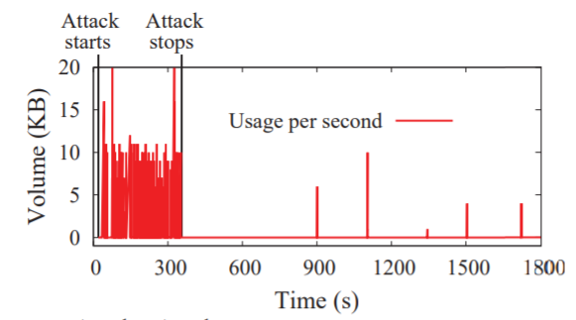
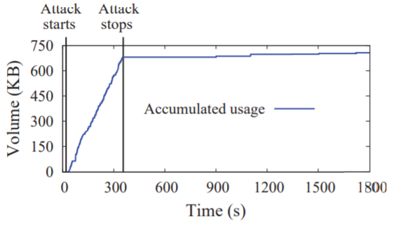
Attack 4: IoT Overcharging
We place 100 VoLTE calls from our smartphone to our test victim smartwatch and records the data usage.
The attack causes the recorded data volume to increase by 681 KB.
Only 3.24 seconds are averagely required by each VoLTE call attempt.
Notes:
To evaluate this attack, we place 100 VoLTE calls from our smartphone to our test victim smartwatch and records the data usage without triggering the ringing tone.
(click)
This figure shows the data used per second during the attack.
(click)
This figure shows the incremental data volume.
(click)
The attack causes the recorded data volume to increase by 681 KB.
Only 3.24 seconds are averagely required by each VoLTE call attempt.
Note that during our attack, the smartwatch never rings.

Slide 45
Part I
Background
Vulnerabilities
Proof-of-concept Attacks
Solution
Notes:
Next is our proposed solution.

Slide 46
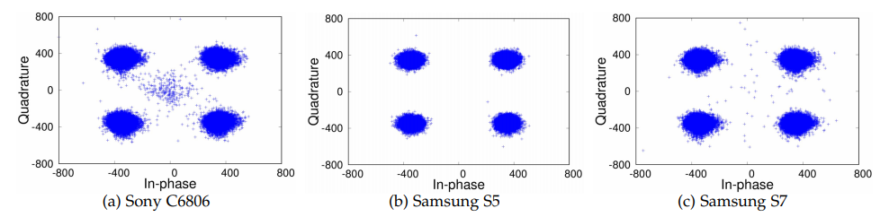
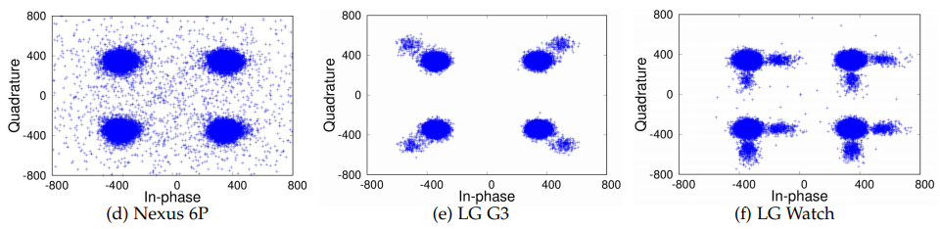
Why is it hard to secure Cellular IoT service charging?
Identifying devices is challenging!
Profiling-based device identification.
Limited data?
Hardware-based device identification.
ARM TrustZone
RF fingerprint-based device identification.
Notes:
Before we move to the proposed solution, let’s first take a look at Why is it hard to secure Cellular IoT service charging.
(click)
First, identifying devices is challenging.
(click)
For example, profiling-based device identification, due to the limited resource of IoT devices, IoT devices may not have a lot of traffic. The operator may identify the IoT devices based on low-traffic profiles. However, such approach has two technical issues. First, data usage patterns vary with users. It is impossible to set the profile for each user. Second, different IoT devices have different data patterns. In the future, more and more IoT devices mean that such approach will cause serious overhead.
(click)
Another way is the hardware-based device identification. E.g., the operator may use the ARM TrustZone hardware module to protect the information including the IMEI. However, not all devices have those modules. The adversary can easily bypass it by Software Defined Radio platforms.
(click)
One approach is to identify the device use RF fingerprint. It may be a good point. To verify the whether RF fingerprint-based device identification works or not, we collected the RF traces of six devices in QPSK. The sony phone, LG phone, and LG watch can be identified easily compared to the other devices. However, such approach is not scalable. To identify the devices, eNB must collect all IoT devices’ RF fingerprints.

Slide 47
Why is it hard to secure Cellular IoT service charging?
Identifying use scenarios is challenging!
Cell-level mobility based identification:
Car-connected hotspots
Stay with in a cell:
Abnormal use or traffic jam or even just stop moving?
Notes:
Another one is that Identifying use scenarios is challenging.
(click)
Take car-connected hotspots as an example. The network has cell-level mobility information of each hotspot, and can keep track of its mobility patterns. However, if a hotspot stays within a cell for a while, it is hard to say there is abnormal use or the car has a traffic jam or maybe the car just stops there.

Slide 48
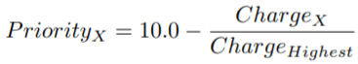
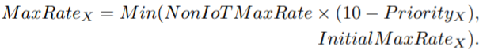
#1: Charge-aware Service Access Control
Cheaper services are assigned to lower priority levels (higher value).
$20 for 2GB Smartphone data plan/ $5 for 2GB smartwatch data plan
Their priorities are 10 – 20/20 and 10 – 5/20, respectively.
Restrict maximum uplink/downlink transmission rates
Notes:
Thus, we developed the standard-compliant solutions to mitigate attack incentives practically.
The first solution is charge-aware service access control.
ChargeX is the device access fee of device X and ChargeHighest is the highest device access fee among the
devices in the same type of data plan in the same network. For example, in a 2GB limited data plan, $20 and $5 are charged for a smartphone and an LG smartwatch, respectively. Their priority levels should be set to 9 and 9.75. Such priority level can be used when operators have limited resources.
After we get the priority level of the service, we next restrict the maximum uplink/downlink transmission rates shown in the function. Let’s use the above example again. Smartwatch priority is 9.75. We thus will limit the maxrate of the smartwatch based on the minimum value of 25% speed of the smartphone and the initial max rate for smartwatch. Such limitation basically gives the user what they pay.

Slide 49
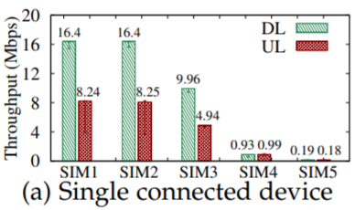
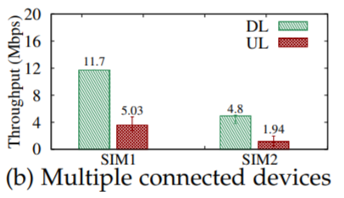
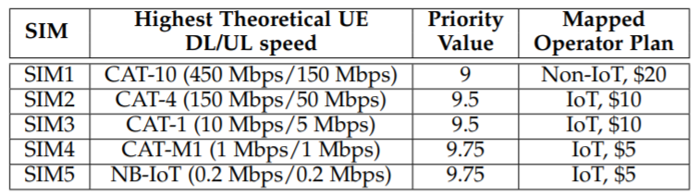
#1: Charge-aware Service Access Control
Solution Setting:
The solution is built on the OAI platform.
We configure the priority value for each SIM based on the SIM category. Each priority level has limited max DL/UL speed.
There are two experiments. (1) Test the DL/UL speed of different SIMs with different profiles on a single device. (2) Test the DL/UL speed of two SIMs with different profiles on two connected device.
The SIM with the more expensive plan has higher priority and further has higher transmission rate.
Notes:
We next build and evaluate this solution on the OAI platform. We use 5 test sims and configure the priority value for each SIM based on its category. We set the max dl/ul rate for each priority level.
The right two figures show that the more expensive plan has higher priority and higher transmission rate.

Slide 50
#2 Flow-based Charging
Different charging policies to multiple traffic types in a single bearer
Different services are be identified by: source/destination IP address, source/destination port number, and packet protocol.
E.g., a VoLTE signaling data flow in OP-I can be represented by the five-tuple: (*, *, VoLTE Server IP, 5060, TCP). Any legal and valid packets transmitted match this pattern shall be considered as the VoLTE traffic.
Notes:
The second solution is flow-based charging. It means that we should apply different charging policies to different traffic in a single bearer.
For example, we can identify the different traffic or services according to the source/destination IP address, port number and the packet protocol.
E.g., in operator one, we know that volte traffic has the fixed pattern. The traffic uses TCP and 5060 port. Thus, legal and valid packets transmitted match this pattern shall be considered as the VoLTE traffic.

Slide 51
Part II: Voice Service
Notes:
Now, let’s start the second part, voice service.

Slide 52
Wi-Fi Calling Services
Wi-Fi Calling services empower mobile users to access voice and text services over Wi-Fi instead of cellular networks.
All of four U.S. major operators have launched Wi-Fi calling services since 2016 – Verizon, AT&T, T-Mobile, and Sprint.
By 2020, Wi-Fi calling services will take 53% of mobile IP voice service usage including VoLTE (26%) and others (21%).
Notes:
As mentioned before, my research project focuses on Voice over wifi, which is wifi calling services.
Although currently the cellular network can cover majority areas, many people may still have the problem to contact others via the wireless cellular network, especially some building areas that the cellular signal may be affected.
Thus, Wi-Fi Calling services empower mobile users to access voice and text services over Wi-Fi instead of cellular networks. All of four U.S. major operators have launched Wi-Fi calling services since 2016.
By 2020, Wi-Fi calling services will take 53% of mobile IP voice service usage including VoLTE (26%) and others (21%).
While users are in an area where cellular signals are very strong , they can still use voice and text services over public or private WiFi networks.

Slide 53
Part 2
Background
Vulnerabilities
Proof-of-concept Attacks
Solution

Slide 54
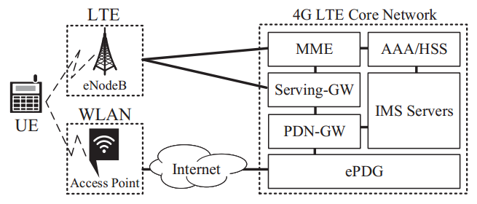
Wi-Fi Calling Services Primer
Specifically, they are SIP-based voice and text services, however, they are using a 3GPP-modified version.
Developed on top of 3GPP IMS (IP Multimedia Subsystem)
Operators use IMS to provide users with IP-based services such as VoIP
It uses the same infrastructure for VoLTE (Voice over LTE) users.
Notes:
First, let’s take at look at the Wi-fi calling services primer. VoWifi is a SIP-based voice and text service, but a 3GPP-modified version is adopted. Similar to VoLTE, VoWiFi is developed on top of 3GPP IMS.
The bottom figure shows the infrastructure for VoWiFi and VoLTE.
The WiFi access point and ePDG (evolved Packet Data Gateway) are newly deployed for WiFi calling users.
For other network elements such as AAA, IMS servers, etc, WiFi calling users share them with VoLTE users.

Slide 55
Wi-Fi Calling Security Mechanisms
Using well-examined 3GPP Authentication and Key Agreement (AKA) and SIM-based security adopted by VoLTE – symmetric cryptography.
All Wi-Fi calling signaling and voice/text packets are delivered through IPsec (Internet Protocol Security) – ciphering and integrity protection.
How does it go wrong?
Notes:
Since Wi-Fi calling service may transmit the data via the public WiFi network, malicious public Wi-Fi network which can freely drop every Wi-Fi calling service signaling and voice packets. Here is some WiFi calling security mechanisms.
First, it uses well-examined 3GPP Authentication and Key Agreement (AKA) and SIM-based security adopted by VoLTE – symmetric cryptography.
Second, all Wi-Fi calling signaling and voice/text packets are delivered through IPsec (Internet Protocol Security) that provide ciphering and integrity protection.
However, according to our study, we found that they are not enough to protect VoWiFi service.
(click)
How does it go wrong?

Slide 56
Part 2
Background
Vulnerabilities
Proof-of-concept Attacks
Solution
Notes:
Next, our discovered vulnerabilities will be introduced.

Slide 57
Finding 1: Wi-Fi calling devices will activate Wi-Fi calling services over an insecure Wi-Fi network
Notes:
Our first finding is that Wi-Fi calling devices will activate Wi-Fi calling services over an insecure Wi-Fi network

Slide 58
Vulnerability 1
Vulnerability – Wi-Fi calling standards don’t exclude insecure Wi-Fi
Two Wi-Fi access point selection modes do not consider security factors
Manual (use a prioritized list)
Automated (ANDSF, Access network discovery and selection function)
Validation:
Deploy an insecure Wi-Fi network using a Wi-Fi router which is vulnerable to ARP spoofing attack – foundation of a variety of MITM attacks
I.e., victim’s WIFI packets will be intercepted and delivered to adversaries
We test whether the Wi-Fi calling devices keep connecting to the above Wi-Fi router
All tested Wi-Fi calling devices connected to the insecure Wi-Fi router!!!
Notes:
It is the first vulnerability. Wi-Fi calling standards don’t exclude insecure Wi-Fi.
There are two wifi selection modes. Manual selection and Automated selection, which use Access network discovery and selection function to select the WiFi accessing point by capabilities and radio quality without considering the security of selected Wi-Fi network.
(click)
We validate it by deploying an insecure Wi-Fi network using a Wi-Fi router which is vulnerable to ARP spoofing attack. It is foundation of a variety of MITM attacks. We test whether the WiFi calling devices will connect to the insecure router. We tested a couple of smartphones and found that (click) All tested Wi-Fi calling devices connected to the insecure Wi-Fi router.

Slide 59
Finding 2: Wi-Fi calling devices do not employ security defense against the common Wi-Fi ARP spoofing attacks
Notes:
Our second finding is that Wi-Fi calling devices do not employ security defense against the common Wi-Fi ARP spoofing attacks

Slide 60
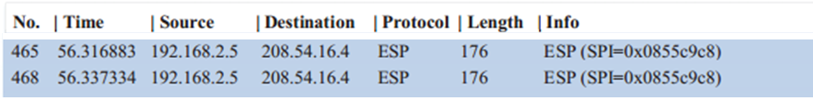
Vulnerability 2
Vulnerability - Wi-Fi calling devices always accept ARP Reply message
All packets sent by Wi-Fi calling devices can be redirected to adversaries
Validation:
Employing EtterCap to send ARP reply message to Wi-Fi calling devices.
Adversaries can capture all Wi-Fi packets sent by the victim
Notes:
It is the second vulnerability, Wi-Fi calling devices always accept ARP Reply message. Under the ARP spoofing attack, All packets sent by Wi-Fi calling devices can be redirected to adversaries.
(click)
To validate this vulnerability, we use EtterCap to send spoofed ARP messages. Therefore, we found that adversaries can capture all WiFi packets sending by the victim as shown in the figure.

Slide 61
Finding 3: Wi-Fi calling devices and infrastructure indeed deploy extra security mechanisms for malicious Wi-Fi attacks, however, it is not enough.
Notes:
Finding 3 is that Wi-Fi calling devices and infrastructure indeed deploy extra security mechanisms for malicious Wi-Fi attacks, however, it is not enough.

Slide 62
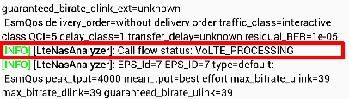
A system-switch mechanism
With the aforementioned two findings, adversaries can launch Wi-Fi Calling service DoS attacks
Discarding all intercepted Wi-Fi signaling and voice/text packets
System-switch (Wi-Fi-> Cellular)
If an user fails to dial a Wi-Fi voice call, the mobile device will switch to use cellular-network-based voice services.
If Wi-Fi calling service operators cannot route an incoming call to users by Wi-Fi calling, the operators will switch it to use cellular-network-based one.
For users, they are free of voice/text DoS attacks.
Notes:
Using the aforementioned vulnerbailities, the adversaries can launch WiFi calling service DoS attacks by Discarding all intercepted Wi-Fi signaling and voice/text packets
(click)
Operators indeed have a system-switch mechanism that can switch the voice service from Wi-Fi to the cellular network.
If an user fails to dial a Wi-Fi voice call, the mobile device will switch to use cellular-network-based voice services.
If Wi-Fi calling service operators cannot route an incoming call to users by Wi-Fi calling, the operators will switch it to use cellular-network-based one.
This figure shows the capture trace that indicate the system-switch starts to work.
(click)
As a result, for users, they are free of voice/text DoS attacks. But does it really make users free of attacks?

Slide 63
Vulnerability 3
Vulnerability 3: Inter-system switch voice service continuity is not revised accordingly
Service continuity can seamlessly switch an ongoing Wi-Fi calling call to back to cellular-network-based voice call
However, it is only triggered while the quality of Wi-Fi radio signals is bad
What if Wi-Fi radio quality is good but Wi-Fi calling service quality is poor?
We start dropping all Wi-Fi calling packets after the call conversation is started (Wi-Fi radio quality is good)
The system-switch security mechanism is bypassed!!
No cellular-based voice call is initiated.
Notes:
Unfortunately, no. Vulnerability 3 is that the Inter-system switch voice service continuity is not revised accordingly. Service continuity can seamlessly switch an ongoing Wi-Fi calling call to back to cellular-network-based voice call. However, it is only triggered while the quality of Wi-Fi radio signals is bad.
(click)
What if Wi-Fi radio quality is good but Wi-Fi calling service quality is poor?
(click)
We start dropping all Wi-Fi calling packets after the call conversation is started (Wi-Fi radio quality is good).
(click)
We are shocked because it bypasses the system-switch security mechanism. No cellular-based voice call is initiated.

Slide 64
Finding 4: Wi-Fi calling service operators do not take extra security mechanisms to protect the encrypted Wi-Fi calling packets
Notes:
Finding 4 is that Wi-Fi calling service operators do not take extra security mechanisms to protect the encrypted Wi-Fi calling packets.
The answer to this question is yes. WiFi calling devices do not avoid to activate wifi calling services in an insecure wifi network.

Slide 65
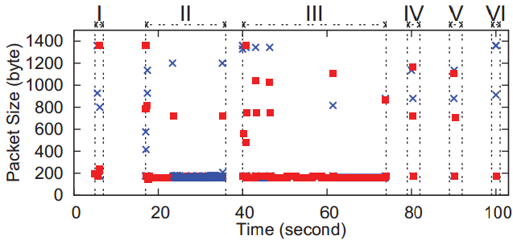
Vulnerability 4
Vulnerability 4: Wi-Fi calling is the only service that is carried by the IPSec channel between the mobile device and ePDG. (operational slip of operator)
Adversaries may infer various Wi-Fi calling events such as dialing calls, receiving calls, etc.
Validation
Six events
Evt I: Activating Wi-Fi calling service
Evt II: Receiving an incoming call
Evt III: Dialing an outgoing call
Evt IV: Sending a text
Evt V: Receiving a text
Evt VI: Deactivating Wi-Fi calling service
Apply C4.5 to analyze IPSec traffic patterns
We are able to infer six Wi-Fi calling events
Notes:
As I mentioned in the beginning, the Wi-Fi calling traffic is protected by the IPSec. However, based on our study, we found that it is still vulnerable to side-channel attacks since Wi-FI calling service is the only service transmitted through the IPSec channel between mobile device and ePDG. It may be exploited to leak user privacy in terms of Wi-Fi calling service events.
(click)
To validate this vulnerability, we start to analyze the WiFi calling trace. Six events are defined including dialing/receiving a call, sending/receiving a text message, and activating/deactivating the service as shown in the figure. X is uplink packets. Red rectangle is downlink packets.
When we apply a simple decision tree algorithm, it can infer all these six calling events even the traffic is protected by IPSec.

Slide 66
Part 2
Background
Vulnerabilities
Proof-of-concept Attacks
Solution
Notes:
Next, I’ll introduce two Proof-of-concept Attacks.

Slide 67
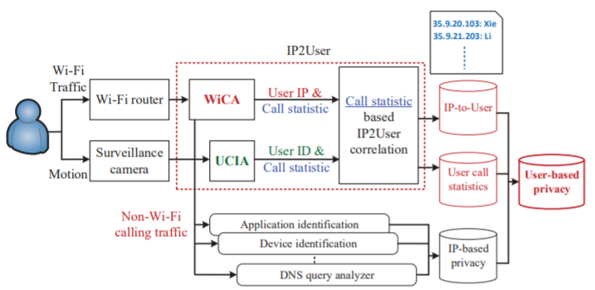
Attack 1: User Privacy Leakage Attack
Developing UPIS (User Privacy Inference System) to launch this attack
WiCA
UCIA
CS-IP2U
Notes:
Attack one is user privacy leakage attack. A User Privacy Inference System shown below is designed and implemented. By this system, the adversary can not only know the application identity, device information, WiFi calling call statistics, but also can map a IP to a real person.
It contains 3 components.
WiCA intercepts all the Wi-Fi packets and then identifies the Wi-Fi calling ones. From the Wi-Fi calling packets, WiCA extracts call statistics (e.g., ringing time and call duration) for each device IP. The other packets are dispatched to a real-time traffic analyzer, which analyzes application identity and device information.
UCIA identifies each phone user’s call statistics based on a surveillance camera using the techniques of face recognition and human motion detection.
CS-IP2U uses the call statistics from both WiCA and UCIA to correlate each phone user with an IP address. It generates a mapping table with IP and user identity, together with each user’s call statistics.
Next, I’ll introduce each component.

Slide 68
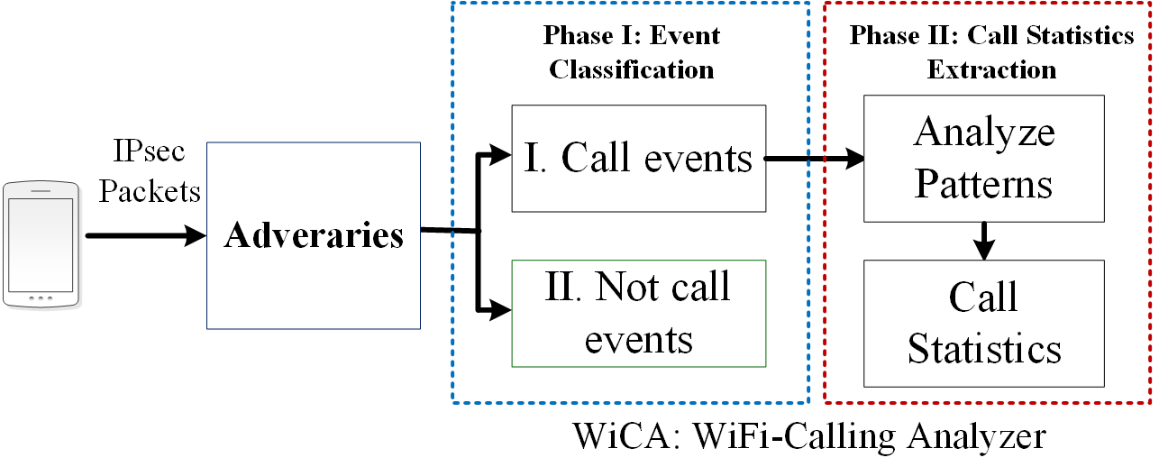
WiCA: Wi-Fi Calling Analyzer
Devising WiCA (Wi-Fi Calling Analyzer) to infer a Wi-Fi calling user’s call statistics
Who initiates the call (an incoming call or an outgoing call)
Who hangs up the call first (caller or callee)
Ringing time (how long the callee answers the call)
Call conversation time
Notes:
First is WiCA. WiFi calling analyzer.
we devise WiCA to infer a Wi-Fi calling user’s call statistics, including who initiates the call, who hangs up the call, ringing time of call, and conversation time of call. WiCA has two phase. Phase one is event classification and phase two is call statistics extraction.
E.g., we may use how many times the person hangs up the call to infer whether he/she is an aggressive person.

Slide 69
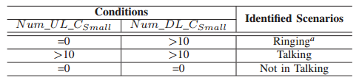
Infer call statistics @ WiCA
Record the number of Uplink and Downlink packets transmitted every 2 seconds
Classify them into three categories by packet size:
Small (<200 bytes), Medium(200-800 bytes), Large (>800 bytes)
Our observations on small packets
Notes:
When it runs, WiCA record the number of uplink and downlink packets as a window per 2 seconds. We classify them into three 3 categories by packet size.
(click)
Based on the experimental results, we observe that when a time window containing 0 small uplink packets and more than 10 small dl packets is normally Ringing event. A time window containing more than 10 UL and DL small packets is Talking status. A time window containing 0 UL and DL small packets is Not in Talking status.

Slide 70
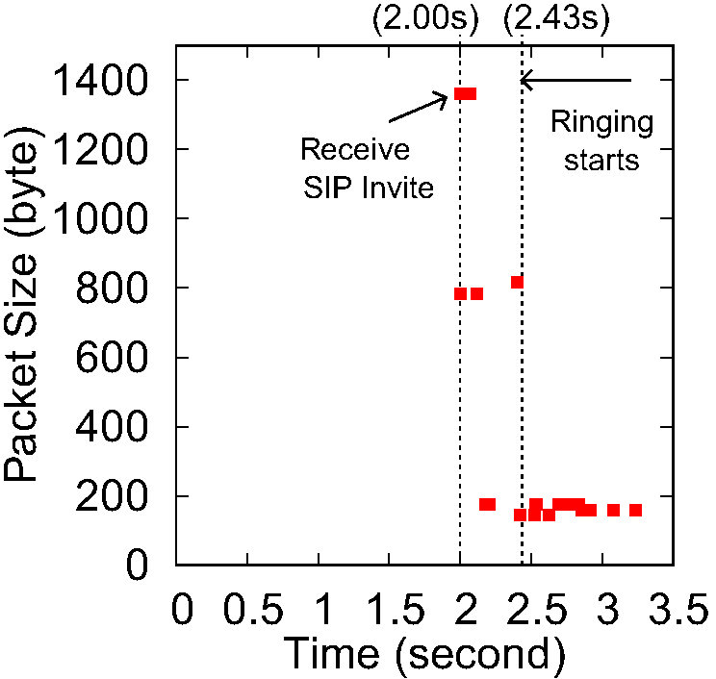
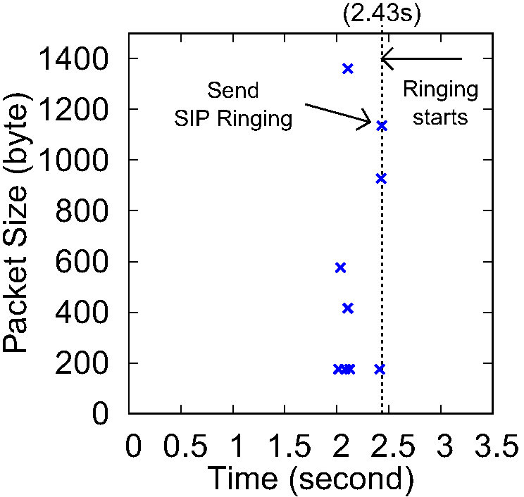
Ringing time inference
Observe that Wi-Fi calling service servers will keep sending small packets to both of caller and callee after SIP RINGING message is sent by the callee.
No uplink small packets after callee’s phone is ringed
Small downlink packets can be used to detect Ringing
Packets sent by Wi-Fi calling server
Packets sent by the callee
Packet arrivals for the event ‘receiving a call with a ringtone’ (callee perspective).
Notes:
Next we will introduce the ringing time inference. We observe that Observe that Wi-Fi calling service servers will keep sending small packets to both of caller and callee after SIP RINGING message is sent by the callee.
(click)
This figure shows the packets sent by WiFi calling server and callee for the event ‘receiving a call with a ringtone’ from callee perspective.
(click)
We can observe that after ringing starts, there will be a lot of small downlink packets, on the other hand (click), there will be no uplink packets from callee.

Slide 71
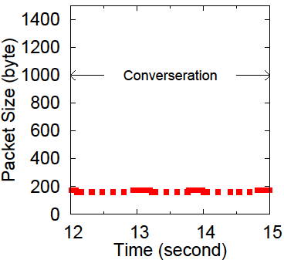
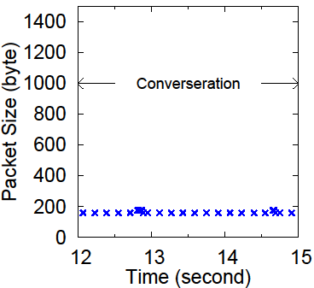
Conversation time inference
We observe small packets on the uplink and downlink during the call conversation
Packets sent by Wi-Fi calling server
Packets sent by the callee
Packet arrivals for ‘Talking’ (callee perspective).
Notes:
This is the conversation time inference. (click) Two figures show the packets sent by server side and callee side for the event ‘talking’.
(click)
We can see that after the ringing start, there will be only small downlink/uplinks packets. In the conversation, we see lots of small packets in both downlink and uplink.
Here is an example of a incoming WiFi calling call. Again, Red rectangle is downlink packets. X is uplink packets.

Slide 72
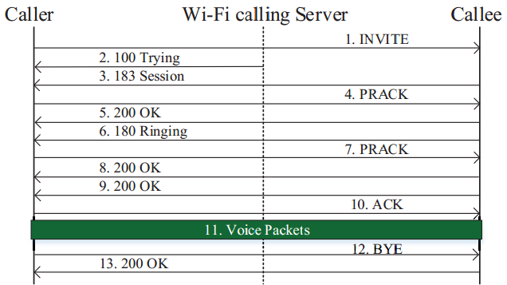
Call initiation and termination inference
Relying on the directions and patterns of large packets
E.g., if the ringing or talking event is detected and the first large packet (SIP INVITE) is sent by the monitored Wi-Fi user => It is an outgoing call
E.g., if the talking and not-talking events are detected and the last large packet (200 OK) is sent by the Wi-Fi server => the monitored Wi-Fi user terminates call first
Notes:
Next is the call initiation and determination inference. It replies on the directions and patterns of large packets.
The left figure is the SIP call flow for a wi-fi calling call. With this flow figure, we can do the call initiation and determination inference. For example, if the ringing or talking event is detected and the first large packet (SIP INVITE) is sent by the monitored Wi-Fi user, It is an outgoing call.
For example, if the talking and not-talking events are detected and the last large packet (200 OK) is sent by the Wi-Fi server, the monitored Wi-Fi user terminates call first.

Slide 73
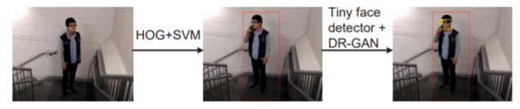
UCIA: User Call and ID Analyzer
Devising UCIA (User Call and ID Analyzer) to identify users and their motions related to making calls.
HOG + SVM (Motion Detection)
Tiny face detector + DR-GAN (Face Detection)
Notes:
The next component is User Call and ID Analyzer. It can identity users and their motions related to making calls.
As shown in the figure, HOG and SVM are responsible for the motion detection. tiny face detector and DR-GAN are used for the face detection.
By UCIA, we can know who made the phone call and when he starts/ends the call.
It mainly leverages four computer vision techniques including a tiny face detector, which is designed to find small faces in a video, DR-GAN (Disentangled Representation learning-Generative Adversarial Network), HOG (Histogram of Oriented Gradient) [27], and SVM (Support Vector Machine).

Slide 74
CS-IP2U: Correlating IP with User Identity
Correlating user identities with IP addresses based on the call statistics extracted by WiCA and UCIA.
Two events are considered:
call start
call end
In WiCA, a VoWiFi call has a call start time TCStart_w and a call end time TCEnd_w.
In UCIA, a call start time and a call end time can also be detected labeled as TCStart_u, TCEnd_u.
If the call start time and call end time from WiCA and UCIA match with a time offset, the corresponding IP and ID are correslated.
Notes:
In the component Correlating IP with User Identity, it can Correlating user identities with IP addresses based on the call statistics extracted by WiCA and UCIA by the call start and call end events.
(click)
We define the start time/end time for both WiCA and UCIA. If the call start time and call end time from WiCA and UCIA match with a pre-defined time offset, the corresponding IP and ID are correslated.
Since for WiCA, we can know the relationship between IP and call statistic.
For UPIS, we can know the relationship between ID and call statistic.
Using call statistic as a bridge, we can correslate ID and IP.

Slide 75
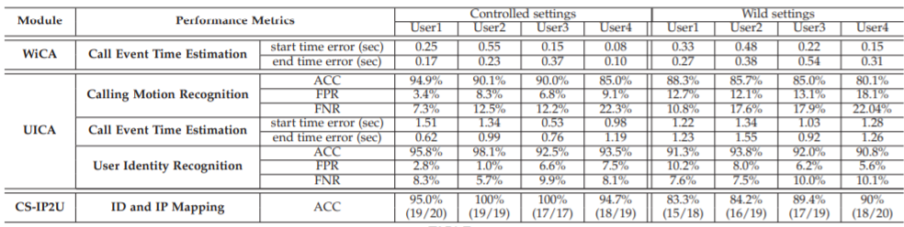
Performance of UPIS
Two experiment setting:
Using non-wild settings (without passersby)
Using wild settings (with passersby)
The IP-ID mapping accuracy is 97.33% in controlled settings and 87% in wild settings.
Notes:
We consider four participants in the experiment. We had two experiment setting to test the robust of UPIS system. One without passersby. One with passersby.
In each test, each of them is requested to dial at least one call; they are allowed to do any random actions (e.g., looking at the ground). To emulate a real use scenario, we do not restrict the duration of each Wi-Fi calling call. The experiment includes 10 tests, and 10 videos are recorded.
This figure shows the overall performance of our UPIS system. It is seen that the IP-ID mapping accuracy is 97.33% in controlled settings and 87% in wild settings. It is seen that the passersby did lower the accuracy a little bit. The reason is that the unexpected passersby can affect the performance of the motion and identity recognition mechanisms. We leave the further improvement to our future work.

Slide 76
Attack 2: THDoS (Telephony harassment or denial of voice service attack)
A telephony harassment or denial of voice service attack against Wi-Fi calling users.
It can bypass the security defenses deployed on Wi-Fi calling devices and the infrastructure.
The attack is based on the manipulation of the delivery of Wi-Fi calling signaling and voice packets for an ongoing call.
It contains several variants.
Notes:
The second attack is Telephony harassment or denial of voice service attack
(click)
This attack can bypass the security defenses deployed on Wi-Fi calling devices and the infrastructure.
(click)
The attack is based on the manipulation of the delivery of Wi-Fi calling signaling and voice packets for an ongoing call.
(click)
It contains several variants.

Slide 77
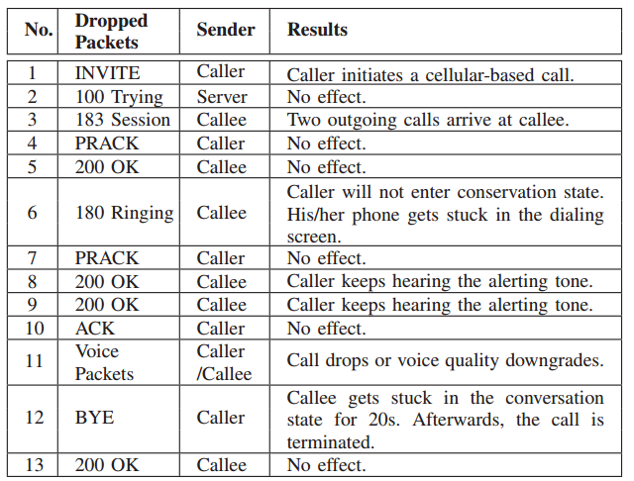
Results of Discarding Wi-Fi Signaling and Voice packets
Wi-Fi calling Call Flow
Notes:
We launch an ARP spoofing attack to intercept all packets between the router and victim device. Based on the identified traffic characteristics of WiFi calling calls, that is what we just introduced during WiCA, and WiFi calling call flow, we are able to identify specific signaling packets and voice packets. So that we launch different kinds of attack by dropping different packets. Right table summarizes the attack result.
For example, if we drop the 180 ringing, caller will not enter conservation state. The phone thus gets stuck in the dialing screen.
If we drop the Bye message, callee will gets stuck in the conversation state for 20s. After that, the call is terminated.

Slide 78
Four Call Attack Variants
Attack Wi-Fi signaling
Annoying-Incoming-Call Attack – keep receiving calls
Caller will be forced to get stuck in the dialing screen without any altering tone
Discarding 180 Ringing message (caller)
Zombie-Call Attack – a call cannot be ended
The caller’s device gets stuck in the dialing screen and will keep hearing the altering tone without starting the conversation.
Discarding 200 OK message (caller)

Slide 79
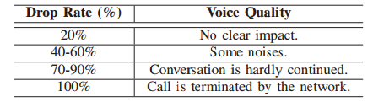
Four Call Attack Variants (cont.)
Attack Wi-Fi voice packets
Mute Call Attack – a muted call
Can only mute a call for 8s, call will be terminated by network
Not terminate the call but only mute the call
Telephony Denial-of-Voice-Service Attack
Can make the conversation be hardly continued
Notes:
We can control the voice quality by controlling the drop rate of voice packets.

Slide 80
Part 2
Background
Vulnerabilities
Proof-of-concept Attacks
Solution
Notes:
The last part is the solution.

Slide 81
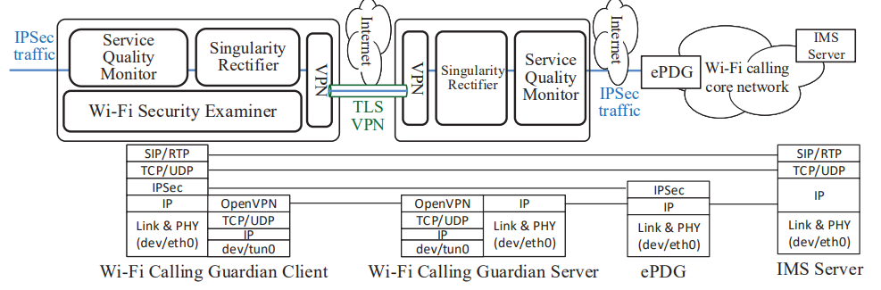
Wi-Fi Calling Guardian
Two parts:
Wi-Fi Calling Guardian client on the smartphone
Wi-Fi Calling Guardian Server in a secure private network
Three security modules
Wi-Fi security examiner
Singularity rectifier
Service quality monitor
Notes:
Our solution name is Wi-Fi calling guardian. It contains two parts. Wi-Fi Calling Guardian client on the smartphone and Wi-Fi Calling Guardian Server in a secure private network. (click)
There are three security module.
Wi-Fi security examiner. Singularity rectifier. Service quality monitor.
This figure shows the design of WiFi calling guardian.
Currently, we only have Android version for it.

Slide 82
Wi-Fi Calling Guardian
Wi-Fi security examiner: (Internet Check)
Check if WPA3 is enabled in the connected Wi-Fi network
Check if the Wi-Fi calling device is under an ARP spoofing attack
Singularity rectifier: (Side-channel inference)
Encapsulates all the Wi-Fi calling packets into UDP datagrams for the delivery.
The UDP datagrams with a fixed packet size (e.g., 300 bytes) are generated by both the client and the server
Service quality monitor: (Packet Drop)
The Wi-Fi calling voice service uses the AMR (Adaptive Multi-Rate) audio codec
Check the AMR packet rate
Once any suspicious attack is detected at the client or the server, the inter-system service continuity mechanism is triggered.
Notes:
Wi-Fi security examiner focuses on the Internet check. It can check if WPA3 is enabled in the connected Wi-Fi network. WPA3 requires all the compliant devices to support the PMF (Protected Management Frames) feature, which provides integrity protection over management frames and can thus defend against some Wi-Fi attacks. It also checks if Wi-Fi calling device is under an ARP spoofing attack. It monitors the device’s ARP table and checks whether two different IP addresses associate with the same MAC address.
(click)
Singularity rectifier defends against side-channel inference. It will encapsulates all the Wi-Fi calling packets into UDP datagrams for the delivery.
Also, The UDP datagrams with a fixed packet size (e.g., 300 bytes) are generated by both the client and the server.
(click)
Service quality monitor can defend against deny of service attack. The Wi-Fi calling voice service uses the AMR (Adaptive Multi-Rate) audio codec. It will Check the AMR packet rate. Once any suspicious attack is detected at the client or the server, the inter-system service continuity mechanism is triggered.

Slide 83
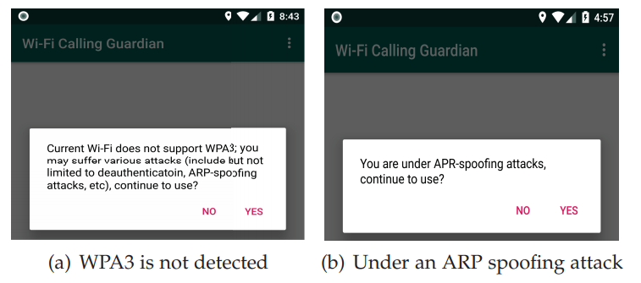
Wi-Fi security examiner
It can detect the WPA3 via WiFiManager class.
It can detect whether two entries share the same MAC address via checking ARP table.
Notes:
WiFi security examiner can detect the WPA3 via WiFiManager class. can detect whether two entries share the same MAC address via checking ARP table.

Slide 84
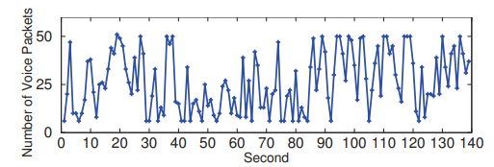
Singularity rectifier
Data padding, packet fragmentation, dummy packets are performed.
The aforementioned attack model no longer works.
Notes:
In Singularity rectifier, Data padding and packet fragmentation are performed. So that vowifi no longer has no packet duration and large packets for SIP message. This figure shows a trace of packets after we employing Singularity rectifier. The man-in-the-middle side-channel attack model no longer works.

Slide 85
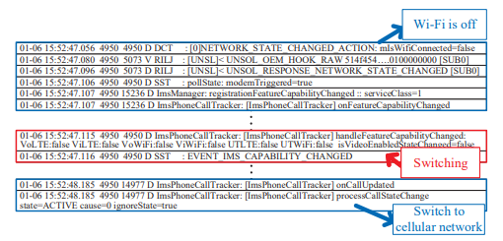
Service quality monitor
Wi-Fi Calling Guardian client checks the AMR packet rate
When denial-of-voice-service attack discards 70% packets is launched, system-system is triggered by service quality monitor.
Notes:
Wi-Fi Calling Guardian client checks the AMR packet rate
When denial-of-voice-service attack discards 70% packets is launched, system-system is triggered by service quality monitor.

Slide 86
Summary of Current Research Results
Any design defects, operational slips, implementation issues can lead to serious negative impacts.
My security research focuses on two key services, mobile data and voice services, of mobile network.
Data service: Different from the state-of-the-art papers that study the data service on the phone, my security research targets on the IoT data service.
Voice service: CSFB and VoLTE have been studied before. My research about VoWiFi fills the last brick of the study about the voice service in LTE era.
Notes:
However, any design defects, operational slips, implementation issues can lead to serious negative impacts on the cellular network.
(click) My security research focuses on two key services, mobile data service and the voice service. Nowadays, more and more people contact friends via apps. Thus, my research does not include the text services.
(click) For data services, some state-of-the-art papers published in CCS have carefully studied the data service on the smartphone. Different from them, my security research targets on the data service specific for the IoT device. Due to the design of IoT, the data service on IoT is different from the data service on the non-IoT device.
(click) For voice service, the academia has studied some common voice technologies including CS Fallback and VoLTE. My research target focuses on another new released technology VoWiFi. To the best of our knowledge, our VoWiFi work was the first work to study VoWiFi and won a Google Security Award.
Voice based (IMS server) (VoWiFi can be extended to 4G/5G)
Data based
Text based. Little people are using it.

Slide 87
Future Work 1
Cellular IoT charging problem on 5G
5G is much more than just fast downloads!
5G has high-speed connectivity, low latency, and ubiquitous coverage.
5G can better support smart vehicles and transport infrastructure such as connected cars, trucks, and buses.
Is 5G network ready to support IoT?
Notes:
As discussed in Project 'How Can IoT Services Pose New Security Threats In Operational Cellular Networks?' and Project 'How Voice Service Threatens Cellular-Connected IoT Devices in the Operational 4G LTE Networks', the unremarkable standard design defects, carrier operational slips, and implementation issues on the IoT device and infrastructure can cause the extremely appalling charging threat to the cellular users and operators.
Compared to the cellular services for smartphones, the services for cellular IoTs are just rolled out. The service plans/mechanisms are changed frequently due to the development of IoT devices. Moreover, cellular IoTs can be more popular in the next 5G network. 5G is much more than just fast downloads; its unique combination of high-speed connectivity, very low latency, and ubiquitous coverage will better support smart vehicles and transport infrastructure such as connected cars, trucks, and buses. The operators will have specific plans to support those cellular IoT devices. Any design defect, operational slip, or implementation issue can cause the devastating problems.
Thus, the study of cellular IoT charging vulnerabilities is still a valuable research topic as the future work.

Slide 88
Future Work 1
Cellular IoT charging problem on 5G
Unremarkable standard design defects?
Carrier operational slips?
Implementation issues on the IoT device and infrastructure?
Any of them can cause the extremely appalling charging threat to the cellular users and operators.

Slide 89
Future Work 2
What can mobile network bring to people?
Non-IoT devices can allow people to use the mobile network for calling, watching the videos, chatting with friend, conducting monetary transactions, browsing websites, etc.
IoT devices allow people easily to access house appliances, use hotspot on vehicles, use wearable devices, etc.
What else can mobile network do?
GSMA Digital Identity Program:
leverage mobile technology as an enabler of digital identity and associated services which provide social and commercial value in developing markets.

Slide 90
Future Work 2
GSMA Digital Identity Program
Enable digital id through the mobile (use the mobile subscription as the digital id) to promote the official ID issuance.
Focus on the social utilizations including voting, banking, education, and healthcare.
GSMA Identity Program is still on its beginning phase.
It is only promoted on the developing countries.
It has limited use scenarios. (i.e., the only use case is that users can use the phone number as the official IDs. )
Can we improve it?
Support more use scenarios?
Online personal IDs?
Support more users?
Support users with 2G/3G/4G/5G?

Slide 91

Questions?
Thanks!

Slide 92
Secure Analysis
Data privacy: data are formally encrypted.
Index privacy: RBF-based index is completely random.
Token privacy: search tokens are generated by non-invertible hash functions.

Slide 93
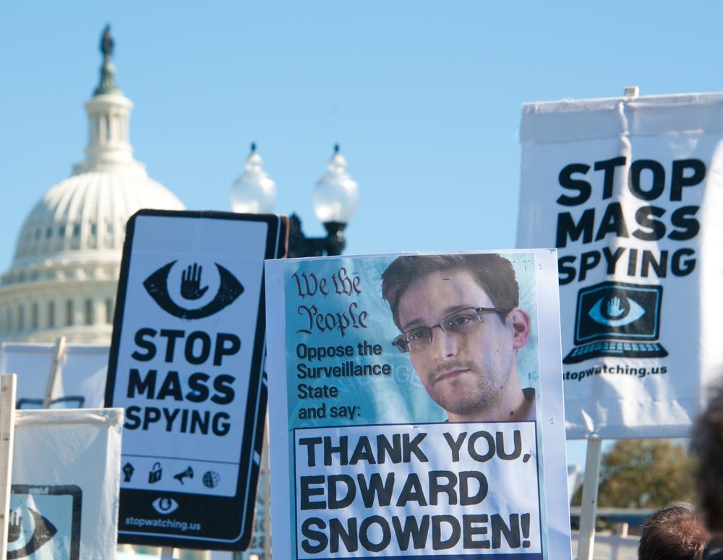
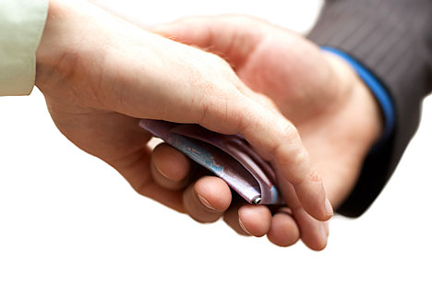


Why Cloud Cannot Be Fully Trusted
Cloud may give your personal data to government or another company
Corrupted cloud employee may peak at your data
Cloud may be hacked
Notes:
On August 31, 2014, a collection of almost 500 private pictures of various celebrities, mostly women, and with many containing nudity, were posted on the imageboard 4chan, and later disseminated by other users on websites and social networks such as Imgur, Reddit and Tumblr. The images were believed to have been obtained via a breach of Apple's cloud services suite iCloud.[1][2][3] Apple later confirmed that the hackers responsible for the leak had obtained the images using a "very targeted attack" on account information, such as passwords, rather than any specific security vulnerability in the iCloud service itself.[4][5][6]

Slide 94
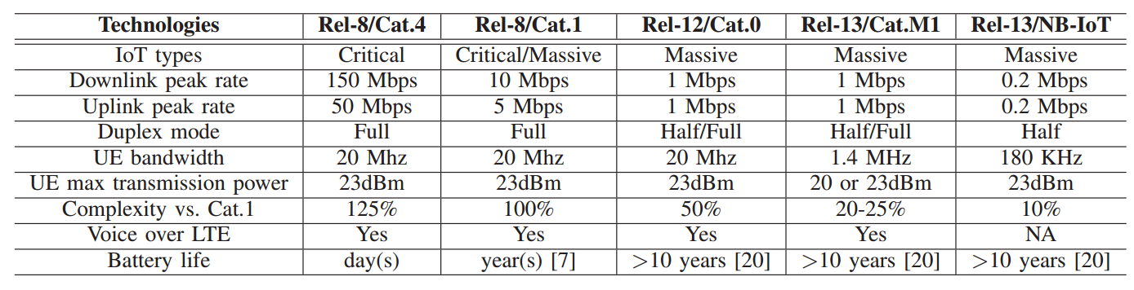
Cellular IoT Technologies in 4G LTE
Various network specifications in the 4G LTE network for diverse demands from IoT services
Widely used
Newly launched
Notes:
After reviewing the network architecture, next I’ll introduce the cellular IoT technologies in 4g lte.
Here we have two IoT types.
Critical applications: traffic/safety control, which requires ultra reliability, low latency, high availability
Massive ones: smart agriculture, which focuses on low cost, low energy, and small data volumes

Slide 95
IoT & Non-IoT in Cellular System ﻿
Cellular Network System
IoT Security
IoT Charging Problem – The charging plan for cellular IoTs is different from smartphones.
Different victims:
Operators are victims.
IoT users are victims.
Non-IoT Security
Voice services on Non-IoT devices have been studied by many works.
VoWiFi is supported by operators since 2016. It empowers mobile users to access voice and text services over Wi-Fi instead of cellular networks
Is VoWiFi as secure as VoLTE?
Notes:
My research topic is mainly about the cellular system. We focus on IoT and Non-IoT devices in the cellular system.
Service-based:
Voice based (IMS server) (VoWiFi can be extended to 3G/4G/5G)
Data based
Text based. Little people are using it.
Why services? Essential cellular service. Resource is limited.
More service security
Emerging cellular service.
Different devices performance on 4G/5G, hyber system
2. merit the cellular network to improve the internet
Data serviced non-iot has been studied before. So we focus on IoT data service
Voice based, volte and vowifi
VoLTE/ VoNR
VoWiFi can be extended to 4G/5G
Publication List:
Voice service (VoWiFi)
Data service
Break LTE on layer – two
DNS server

Slide 96
Solution
Charge-aware Service Access Control:
In LTE, there are 9 priority levels.
Cheaper services are assigned to lower priority levels.
Restrict maximum uplink/downlink transmission rates
Flow-based Charging:
Different charging policies to multiple traffic types in a single bearer
Different services are be identified by: source/destination IP address, source/destination port number, and packet protocol
Notes:
ChargeX is the device access fee of device X and ChargeHighest is the highest device access fee among the
devices in the same type of data plan (e.g., limited or unlimited data plan) in the same network. For example,
in a 2GB limited data plan, $20 and $5 are charged for a smartphone and an LG smartwatch, respectively. Their
priority levels should be set to 9 and 9.75 (i.e., 10.0−$5/$20)

